Slide 1

Data Structures and Algorithms
GirlScript Education Outreach Program

Slide 2

Meet the Mentors!
Pooja Sabnani
Software Engineer, Morgan Stanley
NIT Trichy Alumni
Winner, AI/ML Devengers Hackathon, Microsoft
Top Contributor, GSSoC’19
Cybersecurity and Open Source Enthusiast

Slide 3

Meet the Mentors!
Ankit Bhardwaj
Android Developer
Open Source Contributor
Loves Problem Solving \o/
GGSIPU, Delhi

Slide 4

Meet the Mentors!
Mahir
Student of UIET, Panjab University, Chandigarh
Mentor at Programming Club of UIET
Loves to play CTF
Backend Developer
Connect with me at:
LinkedIn: https://www.linkedin.com/in/mahir-gupta/

Slide 5
Course Curriculum
Day | Topics
1 | Introduction to DS, Time and Space Complexities
2 | Arrays, Linked List, Recursion
3 | Stack, Queue
4 | Trees, BST
5 | Heaps
6 | Introduction to Algorithms, Sorting Algorithms
7 | Divide and Conquer
8-9 | Greedy Technique, Backtracking
10-11 | Dynamic Programming
12-13 | Graphs
14 | STL

Slide 6
Approach of learning:
Github link : https://github.com/py93/DSA-for-Interviews-GirlScript-EOP
Assignments
PRACTICE PRACTICE PRACTICE!!!
Online challenges
Some platforms to practice on:
Power of community: Discuss problems, approaches, ongoing contests.
https://www.geeksforgeeks.org/
https://leetcode.com/
https://www.codechef.com/
https://codeforces.com/
https://www.hackerrank.com/

Slide 7
Introduction to Data Structures
A data structure is a special way of organizing and storing data in a computer so that it can be used efficiently. Array, Linked List, Stack, Queue, Tree, Graph etc are all data structures that stores the data in a special way so that we can access and use the data efficiently.

Slide 8
Types of Data Structures
We have two types of data structures:
1. Linear Data Structure
Elements of Linear data structure are accessed in a sequential manner, however the elements can be stored in these data structure in any order. Examples of linear data structure are: LinkedList, Stack, Queue and Array
2. Non-linear Data Structure
Elements of non-linear data structures are stores and accessed in non-linear order. Examples of non-linear data structure are: Tree and Graph

Slide 9
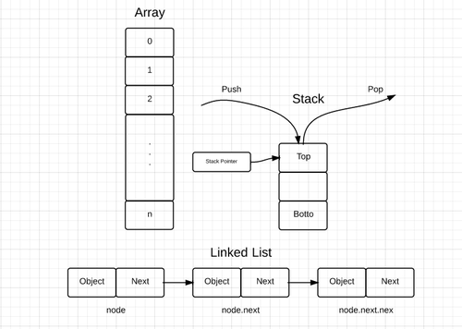
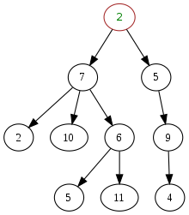

Linear vs Non-Linear Data Structures
Tree
Graph
Linear Data Structures
Non-Linear Data Structures

Slide 10
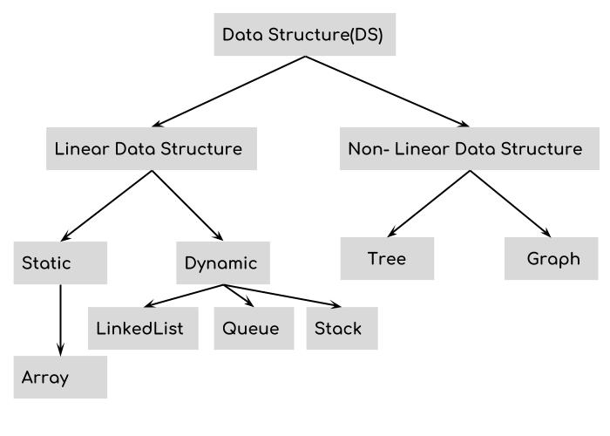

Slide 11
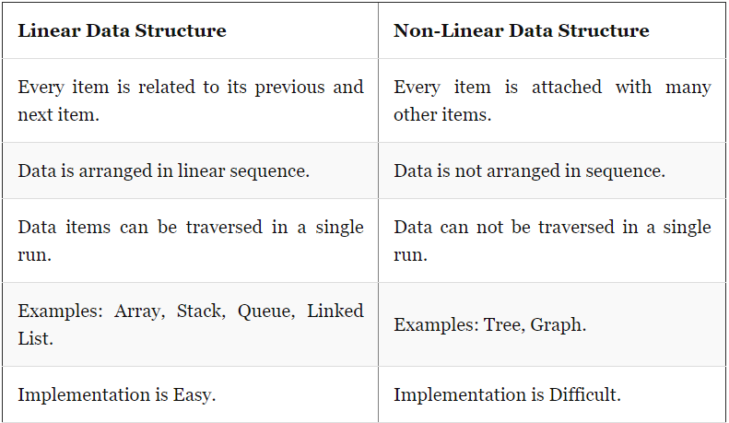
Difference b/w Linear and Non-Linear DS

Slide 12
Basic Operations on Data Structures
1. Traversing : visiting each element of the data structure in order to perform some specific operation
2. Insertion : adding the elements to the data structure at any location.
3. Deletion : deleting an element of the data structure at any location.
4. Searching : finding the location of an element within the data structure
5. Sorting : arranging the data structure in a specific order

Slide 13
Advantages of Data Structures
1. Data Organization :
We need a proper way of organizing the data so that it can accessed efficiently when we need that particular data. DS provides different ways of data organization so we have options to store the data in different data structures based on the requirement.
2. Efficiency
Efficiency of a program depends upon the choice of data structures. For example: suppose, we have some data and we need to perform the search for a particular record. In that case, if we organize our data in an array, we will have to search sequentially element by element. hence, using array may not be very efficient here. There are better data structures which can make the search process efficient like ordered array, binary search tree or hash tables.

Slide 14
Asymptotic Notations
Asymptotic notations are mathematical tools to represent the time complexity of algorithms for asymptotic analysis. The following 3 asymptotic notations are mostly used to represent the time complexity of algorithms:
1. Big-O Notation (Ο) : Big O notation specifically describes worst case scenario. 2. Omega Notation (Ω) : Omega(Ω) notation specifically describes best case scenario. 3. Theta Notation (θ) :This notation represents the average complexity of an algorithm.

Slide 15
Θ Notation
The theta notation bounds a functions from above and below, so it defines exact asymptotic behavior.
A simple way to get Theta notation of an expression is to drop low order terms and ignore leading constants. For example, consider the following expression. 3n³ + 6n² + 6000 = Θ(n³)
Dropping lower order terms is always fine because there will always be a n0 after which Θ(n³) has higher values than Θ(n²) irrespective of the constants involved.

Slide 16
Θ Notation
For a given function g(n), we denote Θ(g(n)) is following set of functions.
Θ(g(n)) = {f(n): there exist positive constants c1, c2 and n0 such that 0 <= c1*g(n) <= f(n) <= c2*g(n) for all n >= n0}
The above definition means, if f(n) is theta of g(n), then the value f(n) is always between c1*g(n) and c2*g(n) for large values of n (n >= n0). The definition of theta also requires that f(n) must be non-negative for values of n greater than n0.

Slide 17
Big O Notation
The Big O notation defines an upper bound of an algorithm, it bounds a function only from above. For example, consider the case of Insertion Sort. It takes linear time in best case and quadratic time in worst case. We can safely say that the time complexity of Insertion sort is O(n^2). Note that O(n^2) also covers linear time.
If we use Θ notation to represent time complexity of Insertion sort, we have to use two statements for best and worst cases: 1. The worst case time complexity of Insertion Sort is Θ(n^2). 2. The best case time complexity of Insertion Sort is Θ(n).

Slide 18
Big O Notation
The Big O notation is useful when we only have upper bound on time complexity of an algorithm. Many times we easily find an upper bound by simply looking at the algorithm.
O(g(n)) = { f(n): there exist positive constants c and n0 such that 0 <= f(n) <= c*g(n) for all n >= n0}

Slide 19
Ω Notation
Just as Big O notation provides an asymptotic upper bound on a function, Ω notation provides an asymptotic lower bound. Ω Notation can be useful when we have lower bound on time complexity of an algorithm. The Omega notation is the least used notation among all three.
For a given function g(n), we denote by Ω(g(n)) the set of functions.
Ω (g(n)) = {f(n): there exist positive constants c and n0 such that 0 <= c*g(n) <= f(n) for all n >= n0}.

Slide 20
Worst, Average and Best Case Time Complexities
When it comes to analyzing algorithms, the asymptotic analysis seems to be the best way possible to do so. This is because asymptotic analysis analyzes algorithms in terms of the input size. It checks how are the time and space growing in terms of the input size.
We can have three cases to analyze an algorithm: 1. Worst Case
2. Average Case
3. Best Case

Slide 21
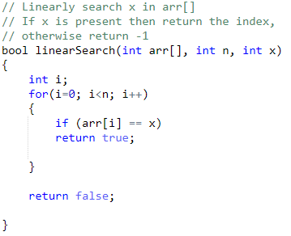
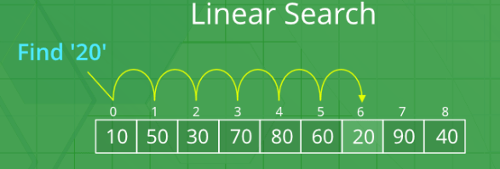
Example : Linear Search

Slide 22
Example : Linear Search
Worst Case Analysis (Usually Done) :
We calculate upper bound on running time of an algorithm. We must know the case that causes the maximum number of operations to be executed.
For Linear Search, the worst case happens when the element to be searched (x in the above code) is not present in the array.
When x is not present, function compares it with all the elements of arr[] one by one.
Therefore, the worst case time complexity of linear search would be O(N), where N is the number of elements in the array.
Best Case Analysis (Bogus) :
We calculate lower bound on running time of an algorithm. We must know the case that causes minimum number of operations to be executed.
In the linear search problem, the best case occurs when x is present at the first location.
The number of operations in the best case is constant (not dependent on N). So time complexity in the best case would be O(1)

Slide 23
Example : Linear Search
Average Case Analysis (Sometimes done):
In average case analysis, we take all possible inputs and calculate computing time for all of the inputs. Sum all the calculated values and divide the sum by total number of inputs. We must know (or predict) distribution of cases.
For the linear search problem, let us assume that all cases are uniformly distributed (including the case of x not being present in array).
So we sum all the cases and divide the sum by (N+1). Following is the value of average case time complexity :
Θ((n+1)*(n+2)/2)/(n+1) = Θ(N)

Slide 24

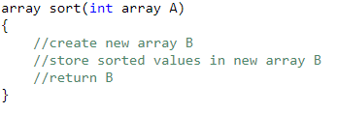
Space Complexity
Space Complexity of an algorithm is total space taken by the algorithm with respect to the input size.
Auxiliary Space is the extra space or temporary space used by an algorithm.
Space complexity includes both Auxiliary space and space used by input.
Example:
Auxiliary Space : O(1)
Auxiliary Space : O(N)

Slide 25
Analysis of Loops
O(1): Time complexity of a function (or set of statements) is considered as O(1) if it doesn't contain loop, recursion and call to any other non-constant time function.
// set of non-recursive and non-loop statements
A loop or recursion that runs a constant number of times is also considered as O(1). For example the following loop is O(1).
// Here c is a constant
for (int i = 1; i <= c; i++) { // some O(1) expressions
}

Slide 26
Analysis of Loops
O(n): Time Complexity of a loop is considered as O(n) if the loop variables is incremented / decremented by a constant amount. For example following functions have O(n) time complexity.
// Here c is a positive integer constant
1) for (int i = 1; i <= n; i += c) {
// some O(1) expressions
}
2) for (int i = n; i > 0; i -= c) {
// some O(1) expressions
}

Slide 27
Analysis of Loops
O(n^{c}): Time complexity of nested loops is equal to the number of times the innermost statement is executed. For example the following sample loops have O(n²) time complexity.
1)
for (int i = 1; i <=n; i += c) { for (int j = 1; j <=n; j ++) { // some O(1) expressions }
}
2)
for (int i = n; i > 0; i -= c) { for (int j = i+1; j <=n; j += c) { // some O(1) expressions
}
}

Slide 28
Analysis of Loops
O(Logn): Time Complexity of a loop is considered as O(Logn) if the loop variables is divided / multiplied by a constant amount.
1)
for (int i = 1; i <=n; i *= c) { // some O(1) expressions
}
2)
for (int i = n; i > 0; i /= c) { // some O(1) expressions }

Slide 29
Analysis of Loops
O(LogLogn): Time Complexity of a loop is considered as O(LogLogn) if the loop variables is reduced / increased exponentially by a constant amount.
// Here c is a constant greater than 1
1)
for (int i = 2; i <=n; i = pow(i, c)) {
// some O(1) expressions
}
// Here fun() is function to find square root or cube root or any other constant root
2)
for (int i = n; i > 1; i = fun(i)) {
// some O(1) expressions
}

Slide 30
Analysis of Loops
How to combine time complexities of consecutive loops? When there are consecutive loops, we calculate time complexity as sum of time complexities of individual loops.
for (int i = 1; i <=m; i += c) {
// some O(1) expressions
}
for (int i = 1; i <=n; i += c) {
// some O(1) expressions
}
Time complexity of above code is O(m) + O(n) which is O(m+n)
If m == n, the time complexity becomes O(2n) which is O(n).

Slide 31
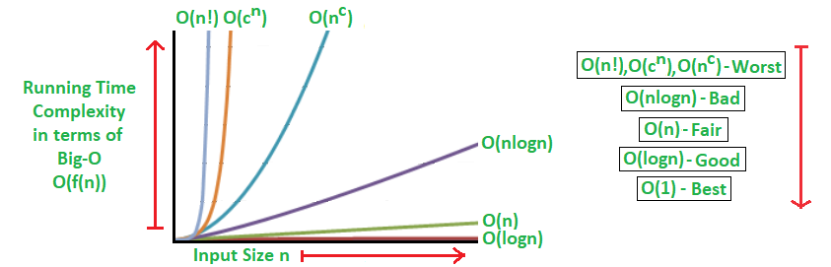
Comparison of Time Complexities

Slide 32
Questions

Slide 33
Exercises:
Find time complexity of given functions:
1. 2.
int fun(int n) { int count = 0; for (int i = 0; i < n; i++) for (int j = i; j > 0; j--) count = count + 1; return count; }
int a = 0,i = N;
while (i > 0)
{
a += i;
i /= 2;
}

Slide 34
Exercises
3.
Which of the given options provides the increasing order of complexity of functions f1, f2, f3 and f4:
f1(n) = 2^n
f2(n) = n^(3/2)
f3(n) = nLogn
f4(n) = n^(Logn)
4.
What is the time complexity of the following code :
int j = 0;
for(int i = 0; i < n; ++i) {
while(j < n && arr[i] < arr[j]) {
j++;
}
}

